Slide 1
Segment Tree

Slide 2

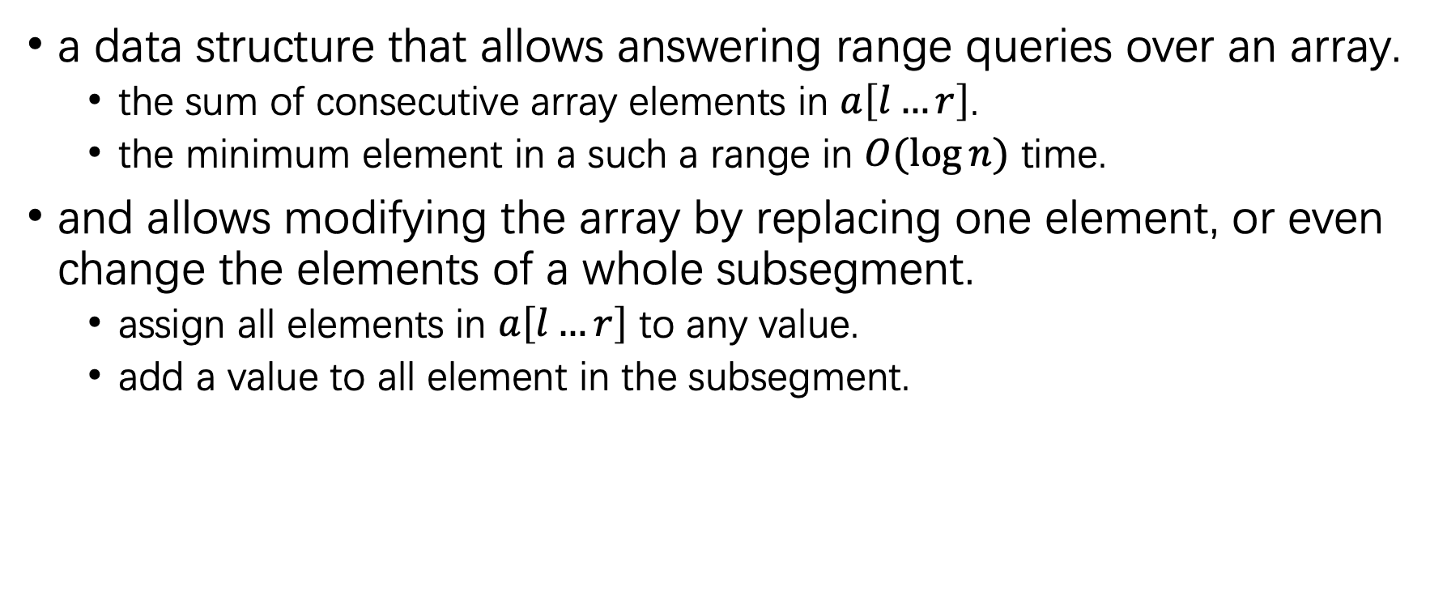
Introduction
a data structure that allows answering range queries over an array.
the sum of consecutive array elements in $a\left[l…r\right]$.
the minimum element in a such a range in $O(\log{n})$ time.
and allows modifying the array by replacing one element, or even change the elements of a whole subsegment.
assign all elements in $a\left[l…r\right]$ to any value.
add a value to all element in the subsegment.

Slide 3
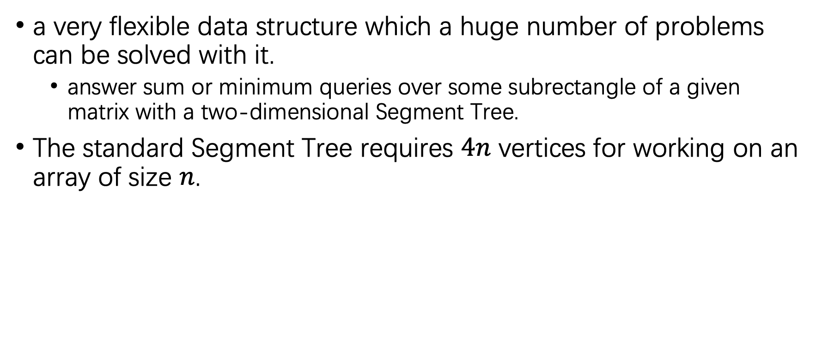
Introduction
a very flexible data structure which a huge number of problems can be solved with it.
answer sum or minimum queries over some subrectangle of a given matrix with a two-dimensional Segment Tree.
The standard Segment Tree requires $4n$ vertices for working on an array of size $n$.

Slide 4
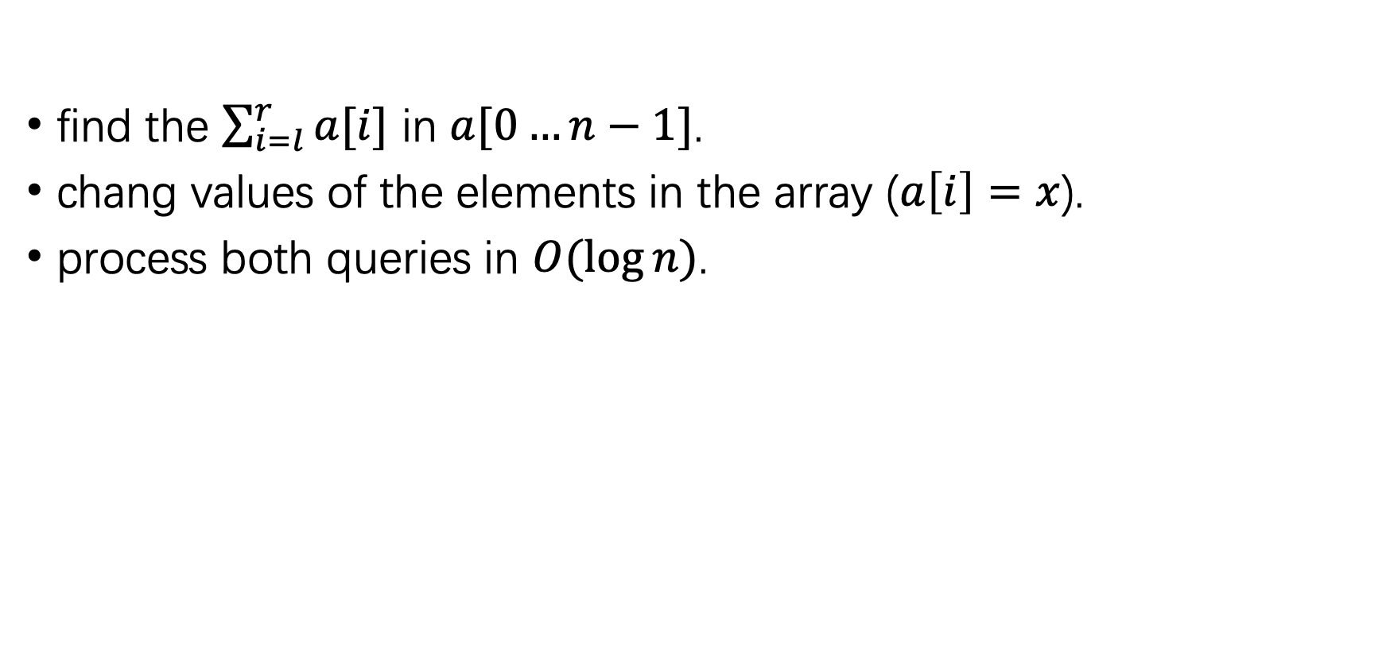
a Segment Tree to answer sum queries
find the $\sum_{i=l}^{r}{a[i]}$ in $a[0…n−1]$.
chang values of the elements in the array ($a\left[i\right]=x$).
process both queries in $O(\log{n})$.

Slide 5
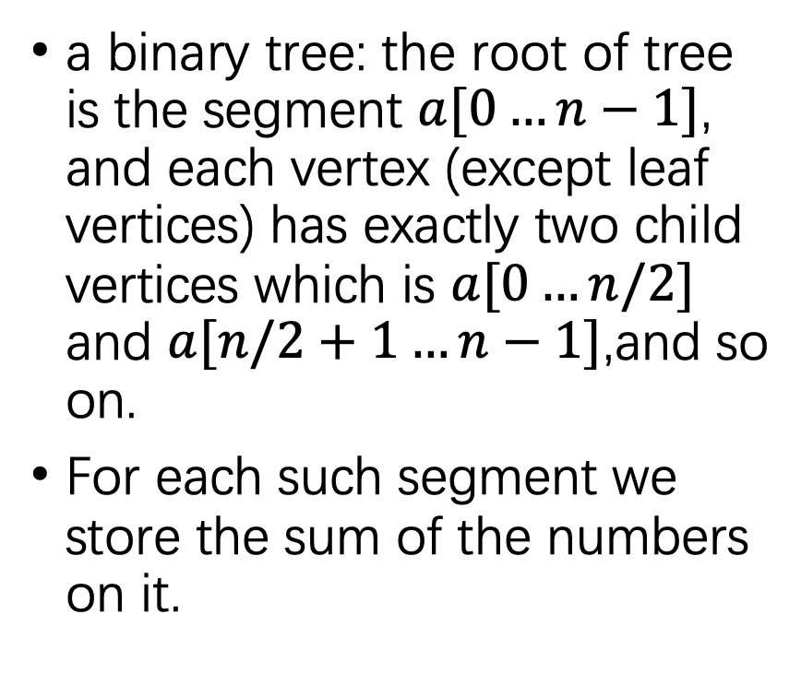
Structure of Segment Tree
a binary tree: the root of tree is the segment $a[0…n−1]$, and each vertex (except leaf vertices) has exactly two child vertices which is $a[0…n/2]$ and $a[n/2+1…n−1]$,and so on.
For each such segment we store the sum of the numbers on it.
a Segment Tree over the array $a=[1,3,−2,8,−7]$

Slide 6
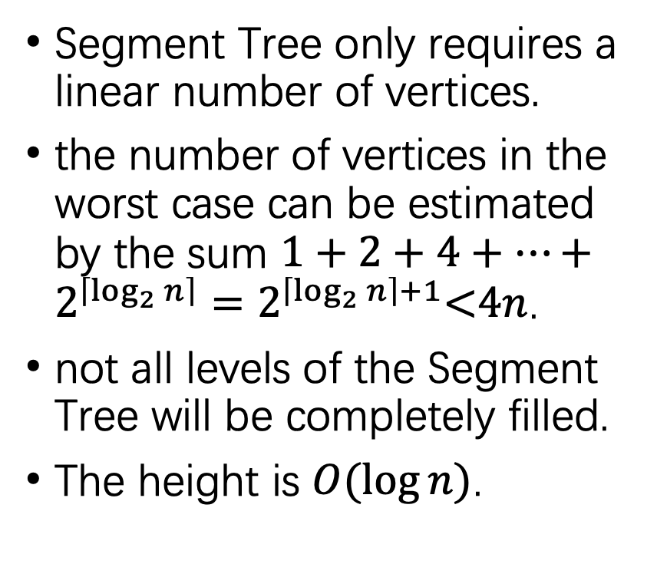
Structure of Segment Tree
Segment Tree only requires a linear number of vertices.
the number of vertices in the worst case can be estimated by the sum $1+2+4+⋯+2^{\left\lceil \log_{2}{n}\right\rceil }=2^{\left\lceil \log_{2}{n}\right\rceil +1}\text{<}\text{4}n$.
not all levels of the Segment Tree will be completely filled.
The height is $O(\log{n})$.
a Segment Tree over the array $a=[1,3,−2,8,−7]$

Slide 7
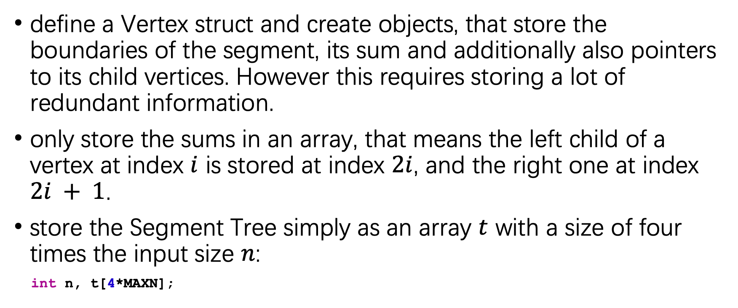
store the Segment Tree
define a Vertex struct and create objects, that store the boundaries of the segment, its sum and additionally also pointers to its child vertices. However this requires storing a lot of redundant information.
only store the sums in an array, that means the left child of a vertex at index $i$ is stored at index $2i$, and the right one at index $2i + 1$.
store the Segment Tree simply as an array $t$ with a size of four times the input size $n$:
int n, t[4*MAXN];

Slide 8
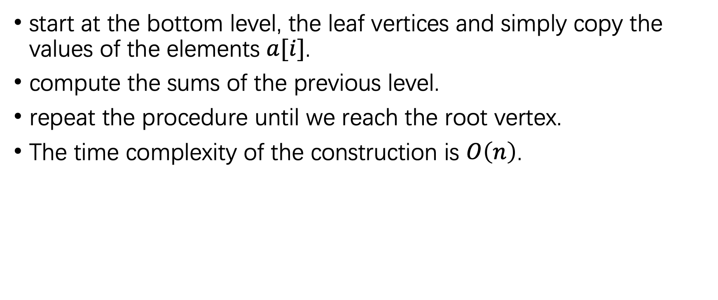
Construction
start at the bottom level, the leaf vertices and simply copy the values of the elements $a[i]$.
compute the sums of the previous level.
repeat the procedure until we reach the root vertex.
The time complexity of the construction is $O\left(n\right)$.

Slide 9
Construction-code
void build(int a[], int v, int tl, int tr) {
if (tl == tr) {
t[v] = a[tl];
} else {
int tm = (tl + tr) / 2;
build(a, v*2, tl, tm);
build(a, v*2+1, tm+1, tr);
t[v] = t[v*2] + t[v*2+1];
}
}

Slide 10
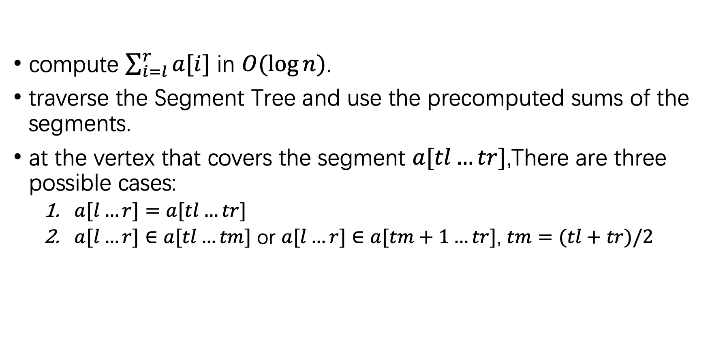
Sum queries
compute $\sum_{i=l}^{r}{a[i]}$ in $O(\log{n})$.
traverse the Segment Tree and use the precomputed sums of the segments.
at the vertex that covers the segment $a[tl…tr]$,There are three possible cases:
$a[l…r]=a[tl…tr]$
$a[l…r]∈a[tl…tm]$ or $a[l…r]∈a[tm+1…tr]$, $tm=(tl+tr)/2$

Slide 11
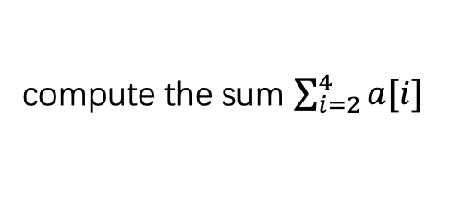
Sum queries
the query segment intersects with both children. make two recursive calls, one for each child.
processing a sum query is a function that recursively calls itself once with either the left or the right child.
the calculation of the query is a traversal of the tree, which spreads through all necessary branches of the tree, and uses the precomputed sum values of the segments in the tree.
compute the sum $\sum_{i=2}^{4}{a[i]}$

Slide 12
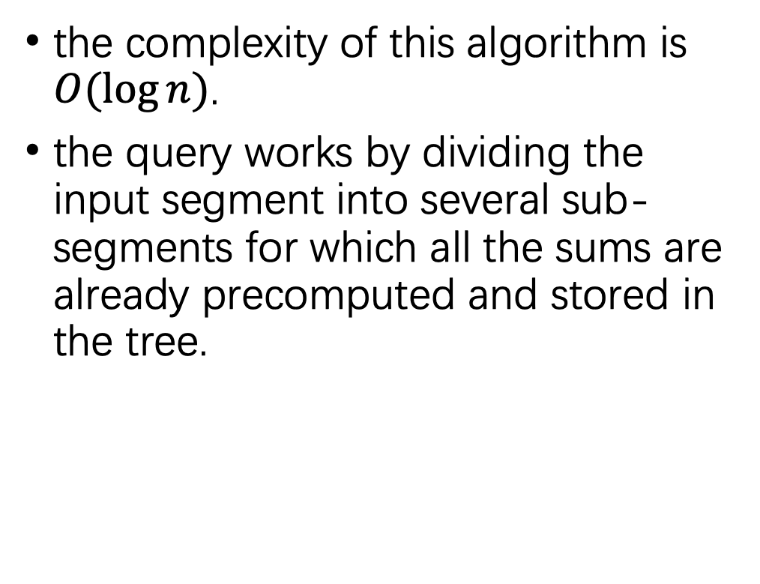
Sum queries
the complexity of this algorithm is $O(\log{n})$.
the query works by dividing the input segment into several sub-segments for which all the sums are already precomputed and stored in the tree.
compute the sum $\sum_{i=2}^{4}{a[i]}$

Slide 13
Sum queries - code
int sum(int v, int tl, int tr, int l, int r) {
if (l > r)
return 0;
if (l == tl && r == tr) {
return t[v];
}
int tm = (tl + tr) / 2;
return sum(v*2, tl, tm, l, min(r, tm))
+ sum(v*2+1, tm+1, tr, max(l, tm+1), r);
}

Slide 14
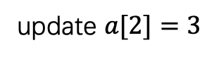
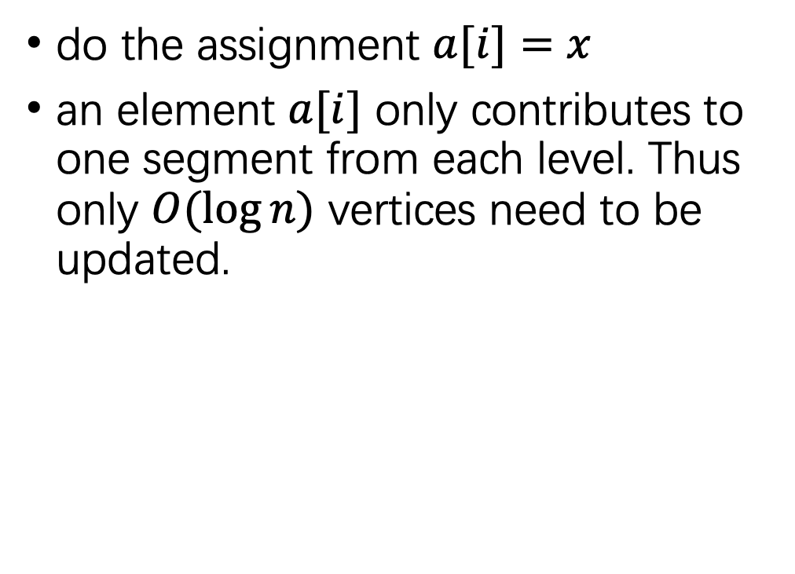
Update queries
do the assignment $a[i]=x$
an element $a[i]$ only contributes to one segment from each level. Thus only $O(\log{n})$ vertices need to be updated.
update $a[2]=3$

Slide 15
Update queries - code
void update(int v, int tl, int tr, int pos, int new_val) {
if (tl == tr) {
t[v] = new_val;
} else {
int tm = (tl + tr) / 2;
if (pos <= tm)
update(v*2, tl, tm, pos, new_val);
else
update(v*2+1, tm+1, tr, pos, new_val);
t[v] = t[v*2] + t[v*2+1];
}
}

Slide 16
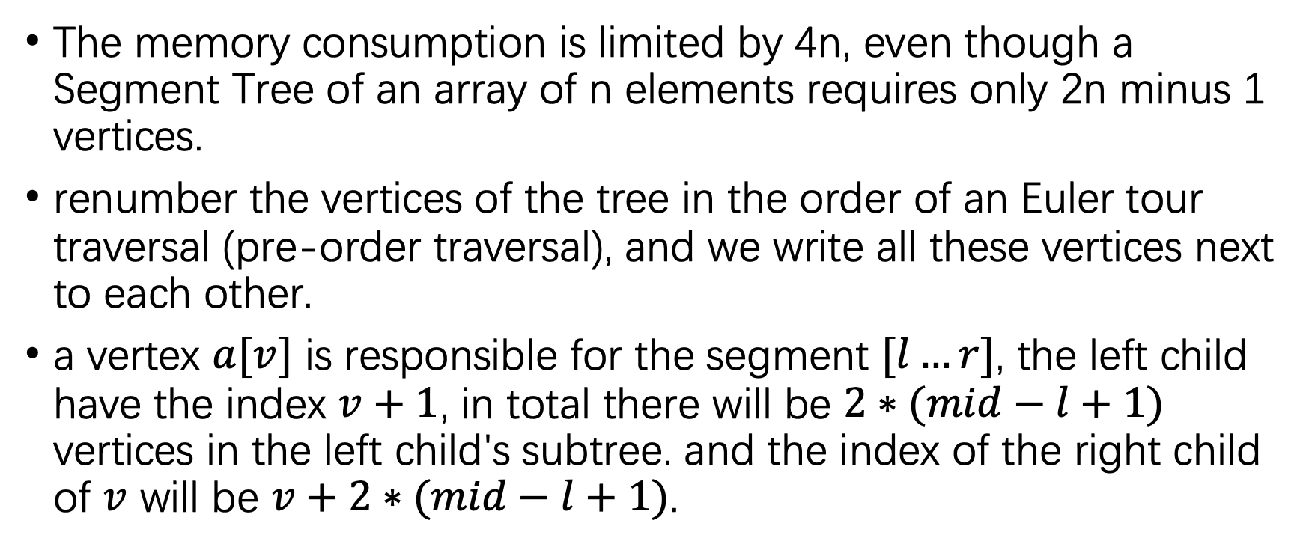
Memory efficient implementation
The memory consumption is limited by 4n, even though a Segment Tree of an array of n elements requires only 2n minus 1 vertices.
renumber the vertices of the tree in the order of an Euler tour traversal (pre-order traversal), and we write all these vertices next to each other.
a vertex $a[v]$ is responsible for the segment $[l…r]$, the left child have the index $v+1$, in total there will be $2∗(mid−l+1)$ vertices in the left child's subtree. and the index of the right child of $v$ will be $v+2∗(mid−l+1)$.

Slide 17
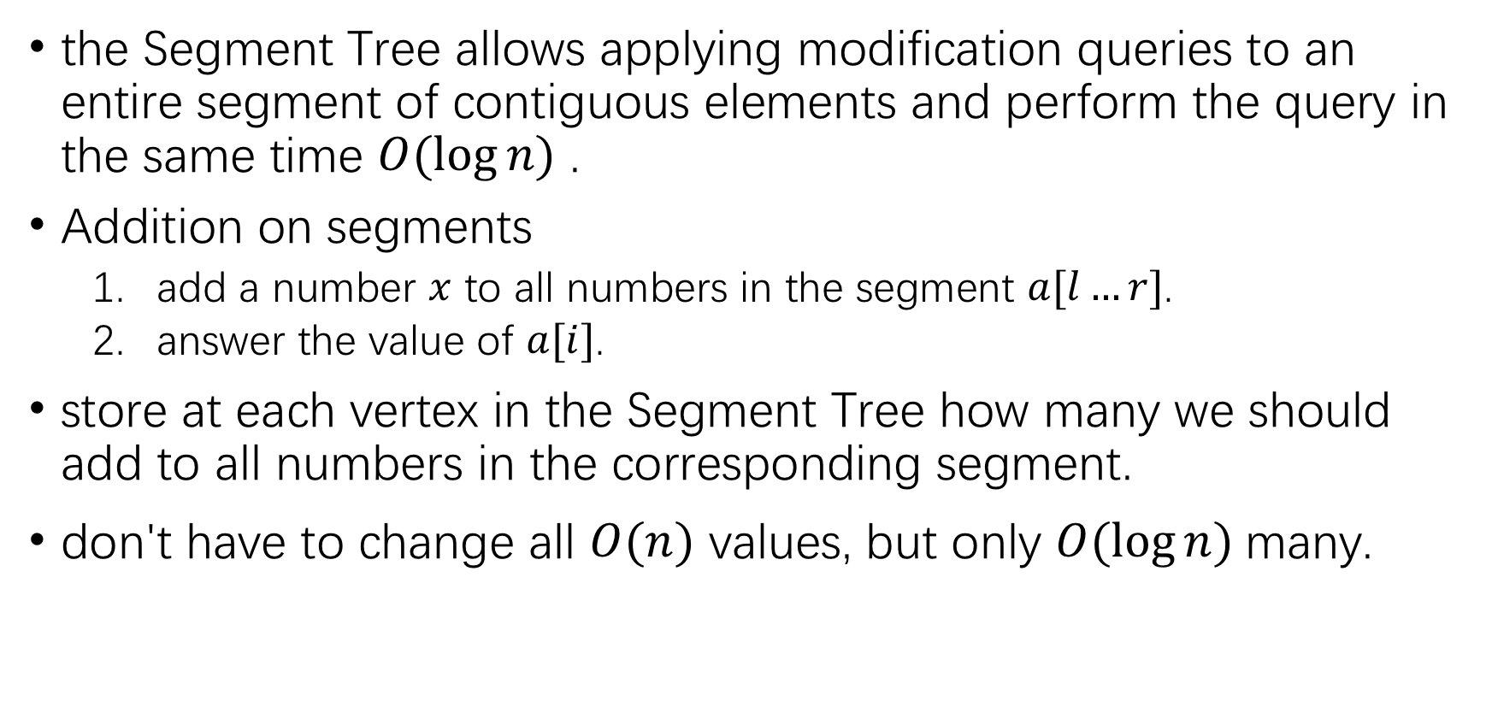
Range updates (Lazy Propagation)
the Segment Tree allows applying modification queries to an entire segment of contiguous elements and perform the query in the same time $O(\log{n})$ .
Addition on segments
add a number $x$ to all numbers in the segment $a[l…r]$.
answer the value of $a[i]$.
store at each vertex in the Segment Tree how many we should add to all numbers in the corresponding segment.
don't have to change all $O(n)$ values, but only $O(\log{n})$many.

Slide 18
Addition on segments- code
void build(int a[], int v, int tl, int tr) {
if (tl == tr) t[v] = a[tl];
else {
int tm = (tl + tr) / 2;
build(a, v*2, tl, tm);
build(a, v*2+1, tm+1, tr);
t[v] = 0;
}
}
void update(int v, int tl, int tr, int l, int r, int add) {
if (l > r) return;
if (l == tl && r == tr) t[v] += add;
else {
int tm = (tl + tr) / 2;
update(v*2, tl, tm, l, min(r, tm), add);
update(v*2+1, tm+1, tr, max(l, tm+1), r, add);
}
}

Slide 19
Addition on segments - code
int get(int v, int tl, int tr, int pos) {
if (tl == tr)
return t[v];
int tm = (tl + tr) / 2;
if (pos <= tm)
return t[v] + get(v*2, tl, tm, pos);
else
return t[v] + get(v*2+1, tm+1, tr, pos);
}

Slide 20
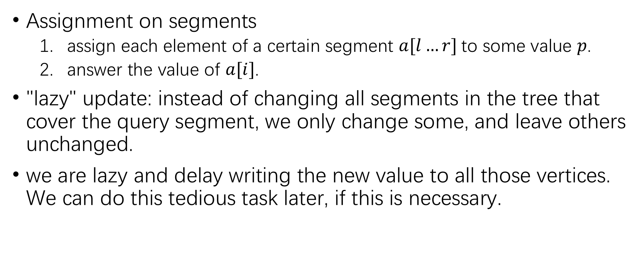
Range updates (Lazy Propagation)
Assignment on segments
assign each element of a certain segment $a[l…r]$to some value $p$.
answer the value of $a[i]$.
"lazy" update: instead of changing all segments in the tree that cover the query segment, we only change some, and leave others unchanged.
we are lazy and delay writing the new value to all those vertices. We can do this tedious task later, if this is necessary.

Slide 21
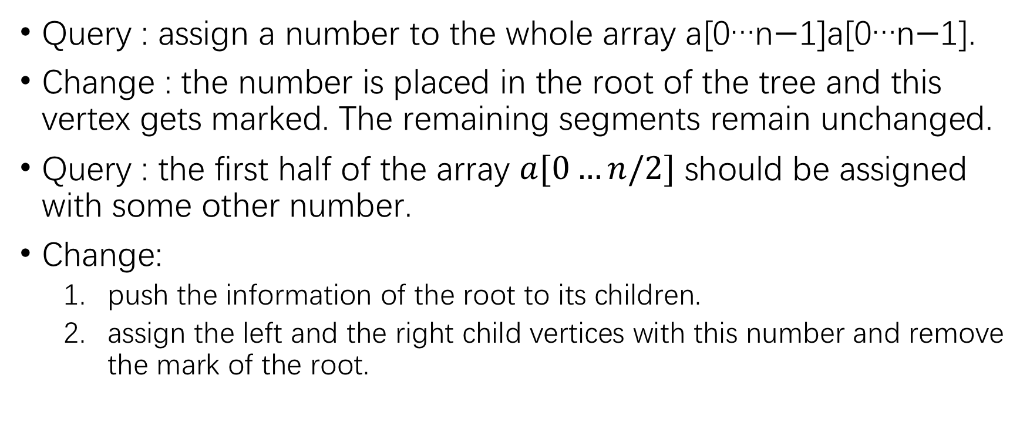
Range updates (Lazy Propagation)
Query : assign a number to the whole array a[0…n−1]a[0…n−1].
Change : the number is placed in the root of the tree and this vertex gets marked. The remaining segments remain unchanged.
Query : the first half of the array $a[0…n/2]$ should be assigned with some other number.
Change:
push the information of the root to its children.
assign the left and the right child vertices with this number and remove the mark of the root.

Slide 22
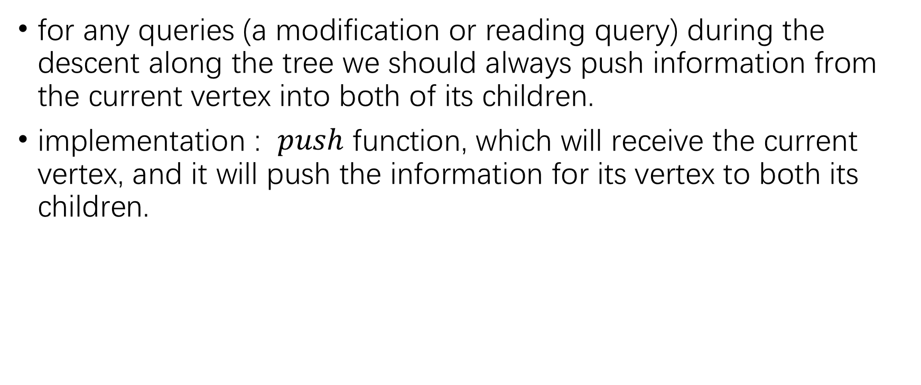
Range updates (Lazy Propagation)
for any queries (a modification or reading query) during the descent along the tree we should always push information from the current vertex into both of its children.
implementation : $push$ function, which will receive the current vertex, and it will push the information for its vertex to both its children.

Slide 23
Assignment on segments - code
void push(int v) {
if (marked[v]) {
t[v*2] = t[v*2+1] = t[v];
marked[v*2] = marked[v*2+1] = true;
marked[v] = false;
}
}
void update(int v, int tl, int tr, int l, int r, int new_val) {
if (l > r) return;
if (l == tl && tr == r) {
t[v] = new_val;
marked[v] = true;
} else {
push(v);
int tm = (tl + tr) / 2;
update(v*2, tl, tm, l, min(r, tm), new_val);
update(v*2+1, tm+1, tr, max(l, tm+1), r, new_val);
}
}

Slide 24
Assignment on segments - code
int get(int v, int tl, int tr, int pos) {
if (tl == tr) {
return t[v];
}
push(v);
int tm = (tl + tr) / 2;
if (pos <= tm)
return get(v*2, tl, tm, pos);
else
return get(v*2+1, tm+1, tr, pos);
}

Slide 25
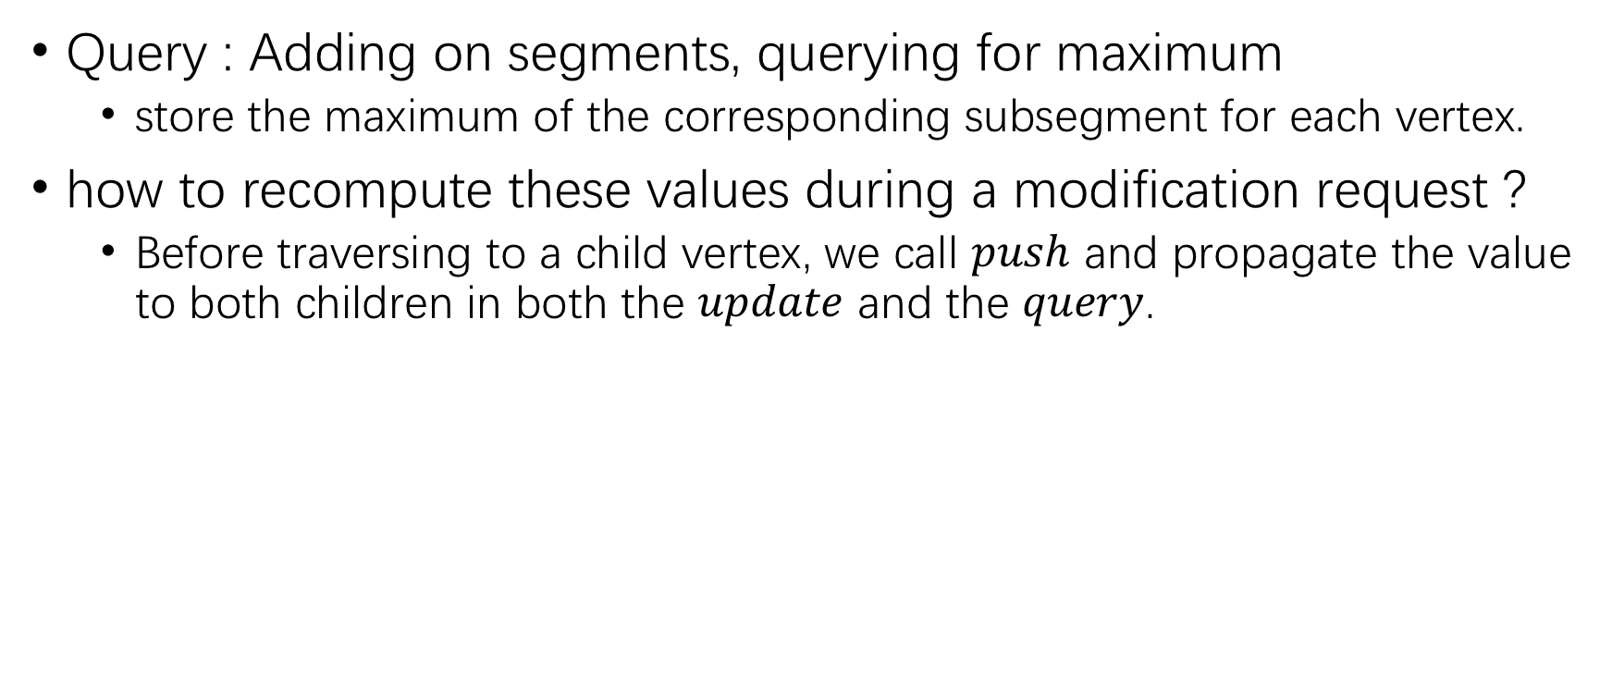
Range updates (Lazy Propagation)
Query : Adding on segments, querying for maximum
store the maximum of the corresponding subsegment for each vertex.
how to recompute these values during a modification request ?
Before traversing to a child vertex, we call $push$ and propagate the value to both children in both the $update$ and the $query$.

Slide 26
Adding on segments , querying for maximum - code
void push(int v) {
t[v*2] += lazy[v];
lazy[v*2] += lazy[v];
t[v*2+1] += lazy[v];
lazy[v*2+1] += lazy[v];
lazy[v] = 0;
}
void update(int v, int tl, int tr, int l, int r, int addend) {
if (l > r) return;
if (l == tl && tr == r) {
t[v] += addend; lazy[v] += addend;
} else {
push(v);
int tm = (tl + tr) / 2;
update(v*2, tl, tm, l, min(r, tm), addend);
update(v*2+1, tm+1, tr, max(l, tm+1), r, addend);
t[v] = max(t[v*2], t[v*2+1]);
}
}

Slide 27
Adding on segments , querying for maximum - code
int query(int v, int tl, int tr, int l, int r) {
if (l > r)
return -INF;
if (l <= tl && tr <= r)
return t[v];
push(v);
int tm = (tl + tr) / 2;
return max(query(v*2, tl, tm, l, min(r, tm)),
query(v*2+1, tm+1, tr, max(l, tm+1), r));
}

Slide 28
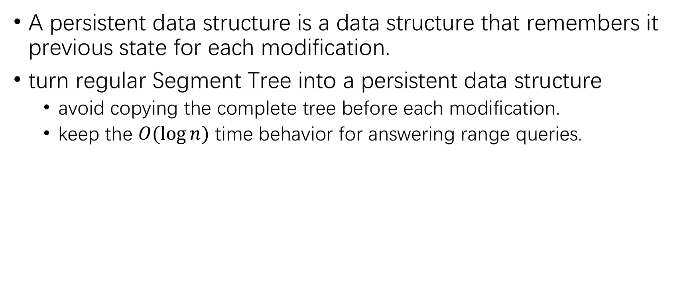
Persistent Segment Tree
A persistent data structure is a data structure that remembers it previous state for each modification.
turn regular Segment Tree into a persistent data structure
avoid copying the complete tree before each modification.
keep the $O(\log{n})$ time behavior for answering range queries.

Slide 29
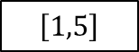
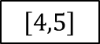
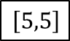
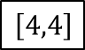
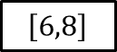
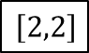
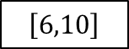
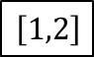
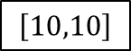
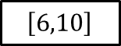
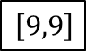
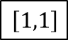
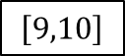
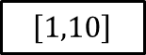
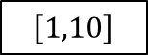
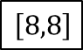
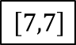
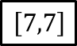
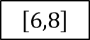
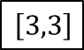
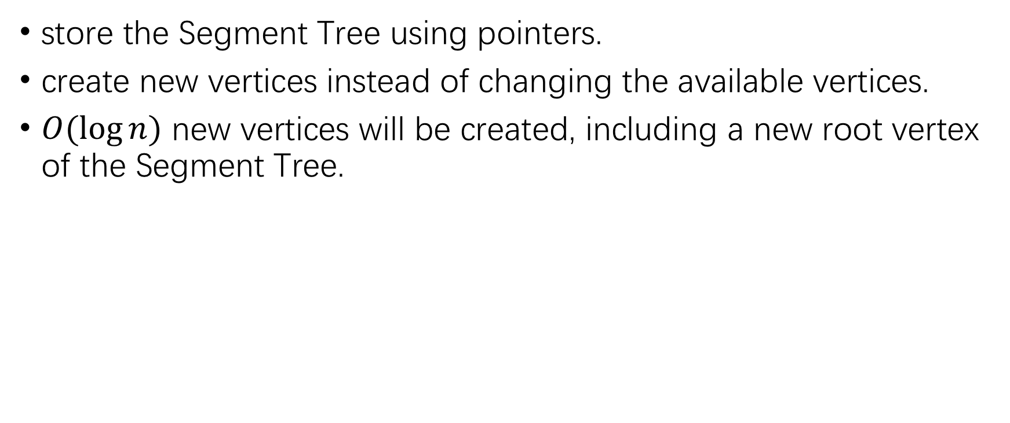
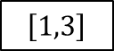
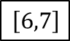
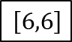
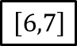
Persistent Segment Tree
store the Segment Tree using pointers.
create new vertices instead of changing the available vertices.
$O(\log{n})$ new vertices will be created, including a new root vertex of the Segment Tree.
$$\left[1,10\right]$$
$$\left[1,10\right]$$
$$\left[1,5\right]$$
$$\left[6,10\right]$$
$$\left[6,10\right]$$
$$\left[1,3\right]$$
$$\left[4,5\right]$$
$$\left[6,8\right]$$
$$\left[9,10\right]$$
$$\left[6,8\right]$$
$$\left[1,2\right]$$
$$\left[3,3\right]$$
$$\left[4,4\right]$$
$$\left[5,5\right]$$
$$\left[6,7\right]$$
$$\left[8,8\right]$$
$$\left[9,9\right]$$
$$\left[10,10\right]$$
$$\left[6,7\right]$$
$$\left[1,1\right]$$
$$\left[2,2\right]$$
$$\left[6,6\right]$$
$$\left[7,7\right]$$
$$\left[7,7\right]$$

Slide 30
Persistent Segment Tree - code
struct Vertex {
Vertex *l, *r;
int sum;
Vertex(int val) : l(nullptr), r(nullptr), sum(val) {}
Vertex(Vertex *l, Vertex *r) : l(l), r(r), sum(0) {
if (l) sum += l->sum;
if (r) sum += r->sum;
}
};
Vertex* build(int a[], int tl, int tr) {
if (tl == tr)
return new Vertex(a[tl]);
int tm = (tl + tr) / 2;
return new Vertex(build(a, tl, tm), build(a, tm+1, tr));
}

Slide 31
Persistent Segment Tree - code
int get_sum(Vertex* v, int tl, int tr, int l, int r) {
if (l > r)
return 0;
if (l == tl && tr == r)
return v->sum;
int tm = (tl + tr) / 2;
return get_sum(v->l, tl, tm, l, min(r, tm))
+ get_sum(v->r, tm+1, tr, max(l, tm+1), r);
}
Vertex* update(Vertex* v, int tl, int tr, int pos, int new_val) {
if (tl == tr)
return new Vertex(new_val);
int tm = (tl + tr) / 2;
if (pos <= tm)
return new Vertex(update(v->l, tl, tm, pos, new_val), v->r);
else
return new Vertex(v->l, update(v->r, tm+1, tr, pos, new_val));
}

Slide 32
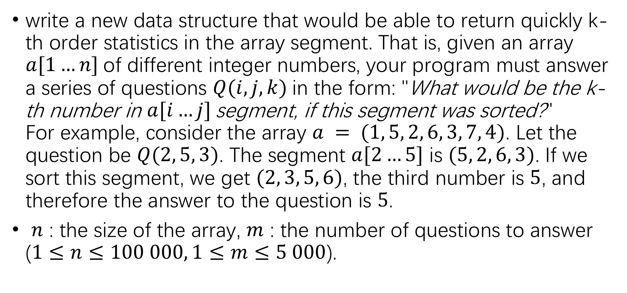
Finding the k-th smallest number in a range
write a new data structure that would be able to return quickly k-th order statistics in the array segment. That is, given an array $a[1…n]$of different integer numbers, your program must answer a series of questions $Q(i, j, k)$in the form: "What would be the k-th number in $a[i…j]$segment, if this segment was sorted?" For example, consider the array $a = (1, 5, 2, 6, 3, 7, 4)$. Let the question be $Q(2, 5, 3)$. The segment $a[2…5]$ is $(5, 2, 6, 3)$. If we sort this segment, we get $(2, 3, 5, 6)$, the third number is $5$, and therefore the answer to the question is $5$.
$n$ : the size of the array, $m$ : the number of questions to answer ($1≤n≤100 000, 1≤m≤5 000$).

Slide 33
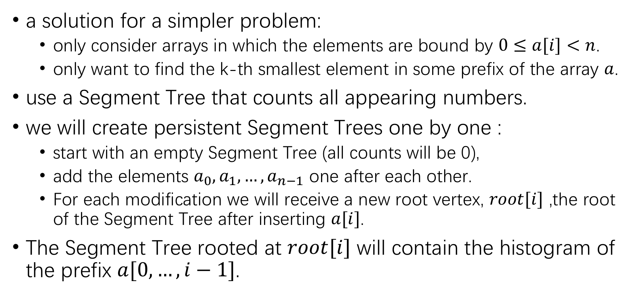
Finding the k-th smallest number in a range
a solution for a simpler problem:
only consider arrays in which the elements are bound by $0≤a[i]<n$.
only want to find the k-th smallest element in some prefix of the array $a$.
use a Segment Tree that counts all appearing numbers.
we will create persistent Segment Trees one by one :
start with an empty Segment Tree (all counts will be 0),
add the elements $a_{0},a_{1},…,a_{n−1}$ one after each other.
For each modification we will receive a new root vertex, $root[i]$ ,the root of the Segment Tree after inserting $a[i]$.
The Segment Tree rooted at $root[i]$ will contain the histogram of the prefix $a[0,…,i−1]$.

Slide 34
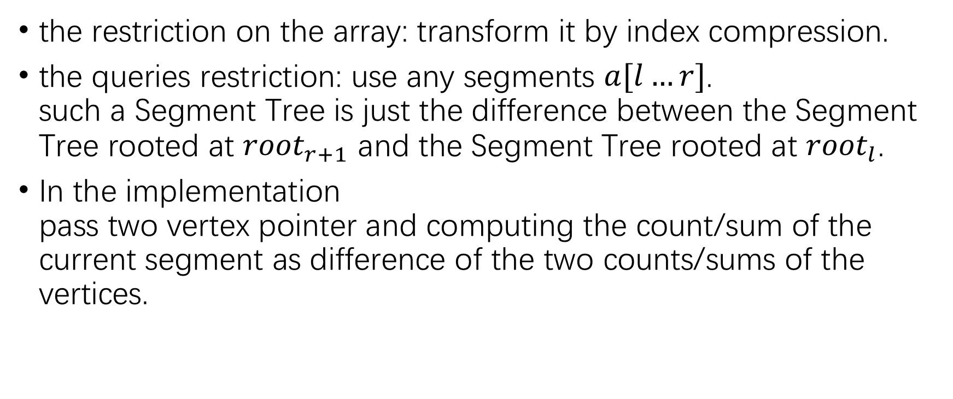
Finding the k-th smallest number in a range
the restriction on the array: transform it by index compression.
the queries restriction: use any segments $a[l…r]$. such a Segment Tree is just the difference between the Segment Tree rooted at ${root}_{r+1}$ and the Segment Tree rooted at ${root}_{l}$.
In the implementation pass two vertex pointer and computing the count/sum of the current segment as difference of the two counts/sums of the vertices.

Slide 35
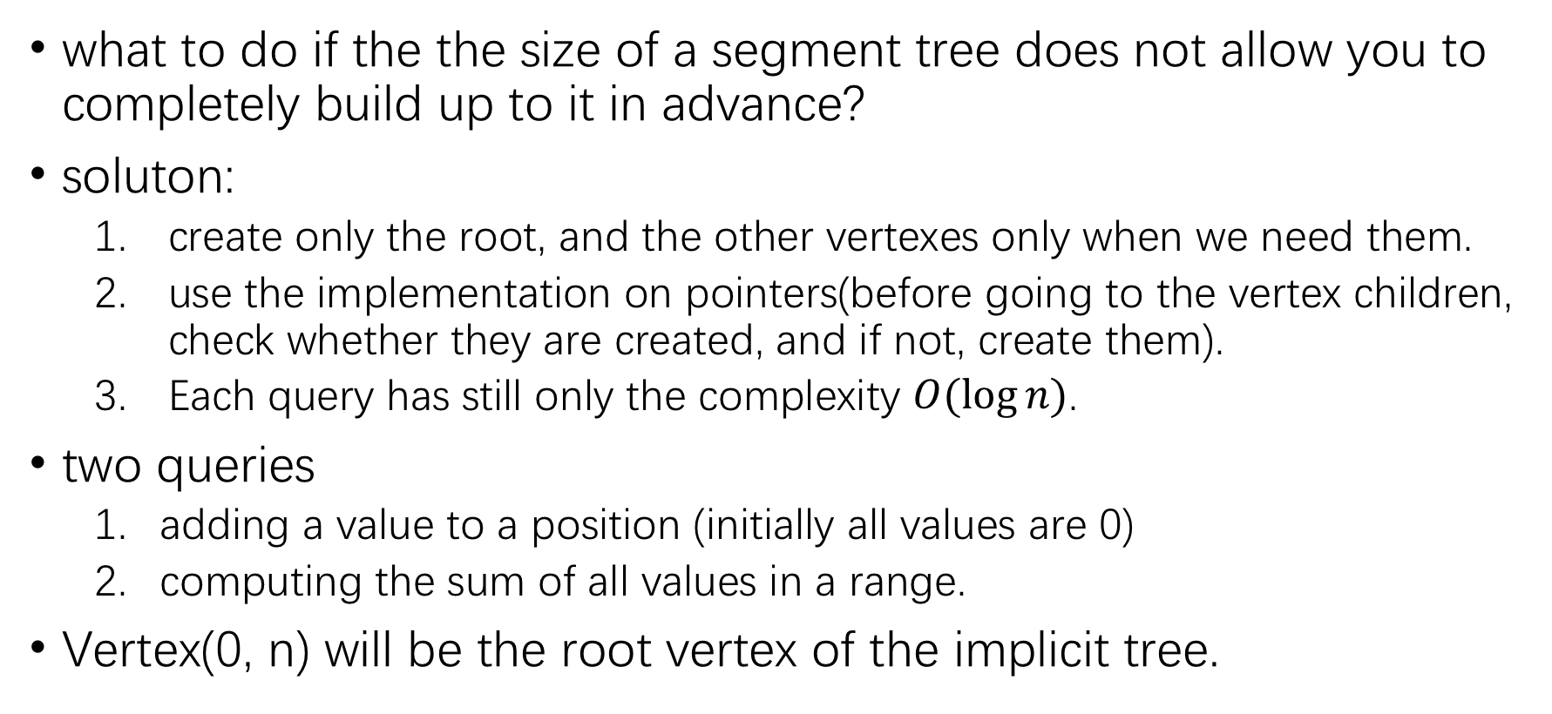
Implicit Segment Tree
what to do if the the size of a segment tree does not allow you to completely build up to it in advance?
soluton:
create only the root, and the other vertexes only when we need them.
use the implementation on pointers(before going to the vertex children, check whether they are created, and if not, create them).
Each query has still only the complexity $O(\log{n})$.
two queries
adding a value to a position (initially all values are 0)
computing the sum of all values in a range.
Vertex(0, n) will be the root vertex of the implicit tree.

Slide 36
The End

